Slide 1
HSC 509: Perspectives on Human Behaviour
Department of Humanities and Social Sciences
Indian Institute of Technology(ISM) Dhanbad
Monsoon Semester 2022-23

Slide 2
Two Narratives in Social Sciences
Ultimate Explanation
Essential Nature of Things
Evidence

Slide 3
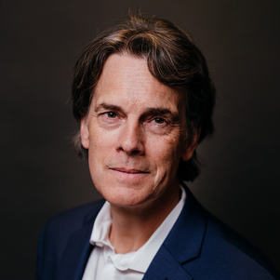
Two Narratives in Social Sciences
Big Bang Narrative
Creation Narrative
[Note: Based on ‘the Philosophy of Education’ lecture series by Prof. Stephen Hicks]

Slide 4
Worldview
Most Fundamental Aspect: MATTER / PHYSICAL
Psychological Nature: Derived from the Physical
Metaphysical: No metaphysics
Purpose of Life: Physical / tangible things
Innate Nature: Progressive and Dominant
Notes:
Metaphysics: no soul, no afterlife
Meaning of life: tangible pleasure
Natural tendency: progressiveness/dominance

Slide 5
The Creation Story
In the beginning there was an ‘Uncreated Being’
This Being created all that exist
How the universe was created, esp. Humans, is matter of theological difference
Most agree that humans are a special creation
Man made from dust and Godly intervention

Slide 6
The Creation Story
Exit from heaven...
Punishment...worldly life
Cycle of Sin - Cleanse
Final Accountability

Slide 7
Research Methodology
Body of Knowledge
Theology
Jurisprudence
Methods
Recitation
Transmission
Grammar and Logic

Slide 8
Worldview
Most Fundamental Aspect: The Uncreated Being
Psychological Nature: Spiritual and Physical
Metaphysical: Soul
Purpose of Life: As desired by the Creator
Innate Nature: Weak and prone to errors

Slide 9
Big Bang Story
Creation Story
Random processes
A person is responsible for his/her own destiny
Individualism
Intelligence and Agency
Destiny has a central role
Collectivism

Slide 10
Two Stories: Fundamental, Nature and Evidence
Big Bang Story
Creation Story
Physical Matter
Physical processes CAUSE all phenomena
Observation
The Uncreated Being
Dual nature (Physical and Spiritual)
Revealation

